Slide 1
MINI PROJECT 2
Regression_Insurance_Data_Archit

Slide 2
Algorithms used:-
1.LinearRegression()
2. DecisionTreeRegressor()
3. KNeighborsRegressor()
4.Lasso()
5. AdaBoostRegressor()

Slide 3
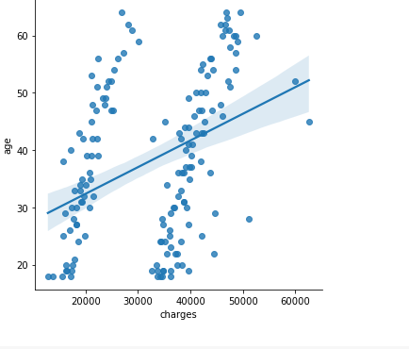
By visualizing the smokers in male we can see that ages between 30 to 40 are higher when compared to others

Slide 4
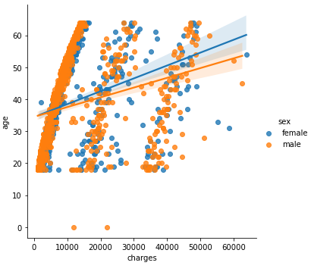
By this plot we can see that charges more in females than male

Slide 5
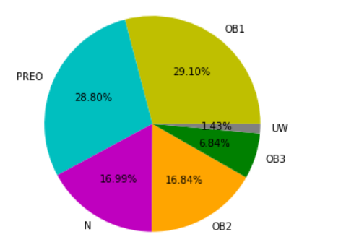
By ploting the pie chart for different classif OB1(ordinary branches) has the highest of 29.10 and with lowest UW(UNDER WRITTER) 1.43

Slide 6
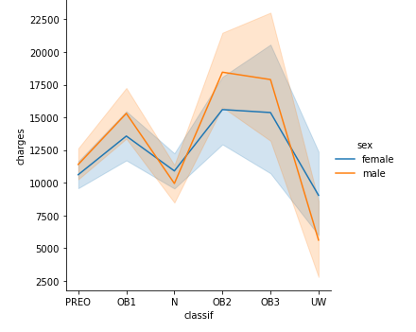
Plot classif vs charges with-respect to gender we can see that male got highest charges in between ob1 to ob2

Slide 7
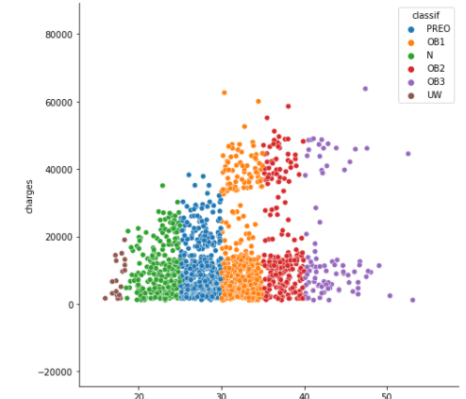
Plot charges vs bmi with-respect to classif In this plot we can see that ob1 and ob2 has got highest numbert of charges

Slide 8
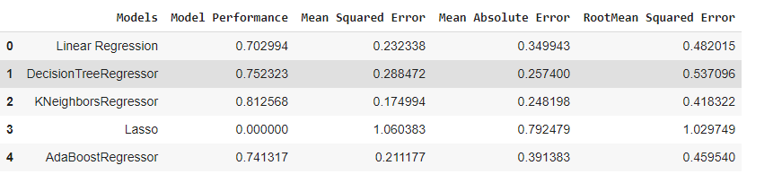
DATAFRAME WITHOUT HYPERPARAMETER TUNING:

Slide 9
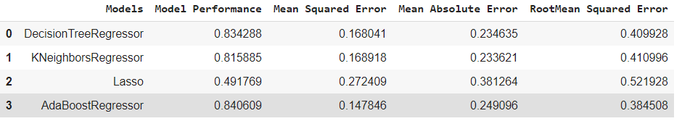
DATAFRAME WITH HYPERPARAMETER TUNING:

Slide 10
Conclusion:
FOR K NEAREST CV-SCORE IS HIGHEST
WITHOUT HYPERPARAMETER TUNING K NEAREST NEIGHBORS IS SHOWING BEST MODEL PERFORMANCE WITH LEAST ERRORS.
WITH HYPERPARAMETER TUNING , EVERY MODEL IS PERFORMING BETTER THAN PREVIOUS BUT ADABOOST IS PERFORMING BEST.

Slide 11
THANK YOU

